Slide 1
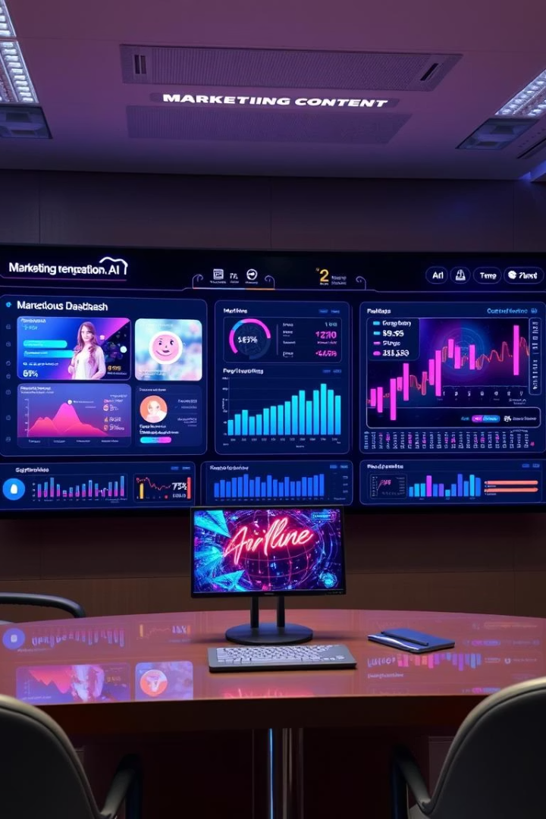

AI For Marketing
Welcome to our AI-powered marketing platform that revolutionizes content creation through advanced artificial intelligence. This project integrates multiple AI models including Gemini API, Ollama, and LangChain to generate marketing slogans, ad copy, and campaign ideas in real-time.
Our platform combines cutting-edge technologies to deliver human-like creativity with data-driven precision, empowering marketers to achieve greater efficiency and innovation in their digital advertising strategies.
by mediboinajagadeesh

Slide 2





Project Objectives
AI-Powered Content Generation
Implement multi-model AI integration for diverse marketing content creation & Leverage Gemini API, Ollama, and LangChain for content creation.
Analysis Capabilities
Develop real-time sentiment analysis and interactive data visualization tools
Speech Functionality
Enable text-to-speech with multiple language support
User Experience
Create an intuitive, user-friendly interface using Streamlit

Slide 3




Data Visualization
Email Content Generator
Social Media Post Generator
Marketing Content Generator
Transform complex data into actionable insights. Use interactive dashboards to track campaign performance.
Create compelling email campaigns with AI. Generate personalized messages tailored to your audience.
Generate engaging content for social media. Optimize posts for different platforms automatically.
Generate creative marketing content instantly. Develop slogans, ad copy, and campaign ideas using AI.

Slide 4
Core Technologies
Gemini API
Ollama
Advanced language model for content generation.
Enables local model deployment for flexibility.
LangChain
Streamlit
Facilitates complex AI workflows and integrations.
User interface that enables interactive application.

Slide 5

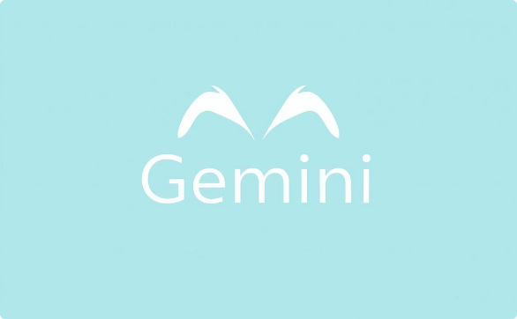




Python 3.11+
AI Models
Streamlit
The foundation of our platform uses Python. It offers extensive libraries and strong community support.
Integration of Gemini API, Ollama, and LangChain enables diverse content generation.
Streamlit provides an intuitive interface and interactive elements to enhance the user experience.
Python 3.11+
Foundation programming language
AI Models
Gemini API, LangChain, Ollama
Streamlit
Frontend framework for user interface
Our platform leverages Python as its foundation, with LangChain managing large language models and ensuring structured prompt execution. Gemini API and Ollama provide advanced natural language processing, with Ollama running locally for fast, private responses. Streamlit creates a user-friendly interactive web interface.
Additional libraries include TextBlob and Langdetect for NLP, gTTS for voice output, and PyTrends for fetching trending topics. Data visualization is handled through Pandas, NumPy, Matplotlib, Plotly, and Altair.

Slide 6







Key Features & Capabilities
AI-Powered Chatbot
Social Media Post Generator
Email Content Generator
Automated customer support is available. The chatbot provides instant responses to inquiries.
Generate engaging content for social media. Create posts tailored for different platforms.
Create professional email content quickly. Includes options for images and logos.
Marketing Content Generator
Data Visualization
Text-to-Speech
Text Analysis & Sentiment Analysis
Interactive data visualization transforms complex data into understandable insights.
Enables multi-language voice output, enhancing content accessibility and user engagement.
AI creates compelling marketing content, including social media posts and email campaigns.
Offers real-time analysis and insights on brand perception and customer sentiment.

Slide 7












Marketing Content Generator Features
AI Chatbot
Social Media
Instant support and responses.
Tailored content for engagement.
Automated support
Platform-specific posts
Instant answers
Enhanced engagement
Email Content
Text-to-Speech
Professional, quick email creation.
Multi-language output for engagement.
Images and logos
Professional content
Text Analysis
Data Visualization
Real-time insights on sentiment.
Transforms data into insights.
Brand perception
Customer sentiment

Slide 8




Implementation Details
AI Chatbot
Email Generation
Social Media Posts
The AI Chatbot uses advanced NLP. This provides instant and relevant answers. It improves user engagement.
Email content generation quickly crafts content. It includes image and logo support for emails.
Posts are dynamically generated for platforms. This provides high engagement and relevance.
Content Generation System
Multiple AI models for diverse creation
Marketing-focused prompt templates
Real-time generation with context awareness
Sentiment Analysis Engine
Advanced emotion detection
Comprehensive emotion mapping
Real-time sentiment scoring
Text-to-Speech System
Multi-language support
Female voice options
Multiple audio format support
Data Visualization
Interactive chart generation
Multiple chart types
Real-time data processing

Slide 9
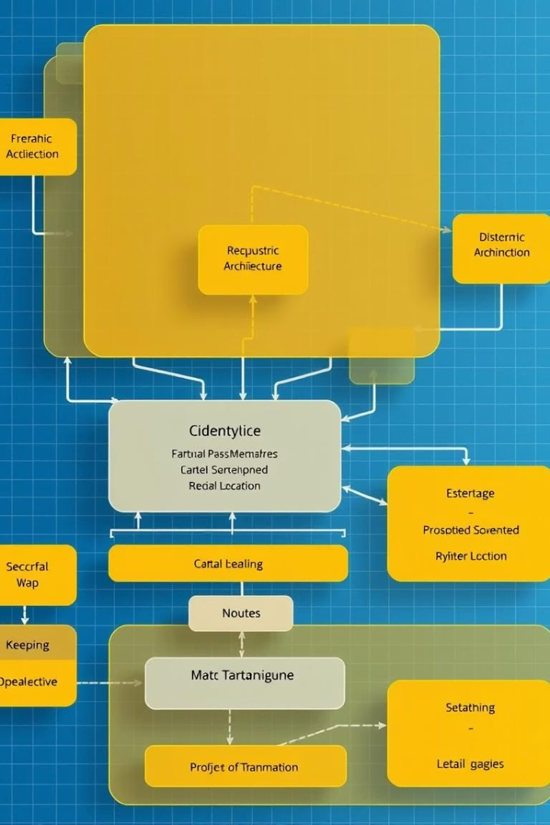
Technical Architecture
Modular Code Structure
The platform features a well-organized, component-based architecture that enables easy maintenance and scalability. Each functional area is encapsulated in dedicated modules with clear interfaces.
Environment Configuration
Configuration settings are managed through environment variables, allowing for flexible deployment across different environments without code changes. This approach enhances security by keeping sensitive information separate.
Asynchronous Processing
The system implements asynchronous processing capabilities to handle multiple requests simultaneously, ensuring responsive performance even under heavy load. This is particularly important for real-time content generation.
Error Handling & Logging
Comprehensive error handling and logging systems capture exceptions and provide meaningful feedback to users while maintaining detailed logs for troubleshooting and improvement.

Slide 10
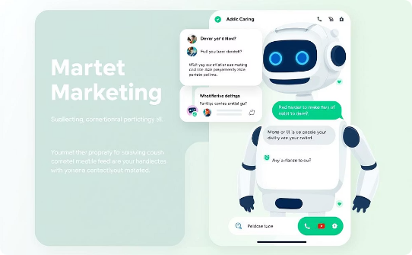
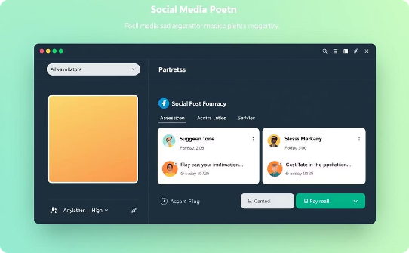
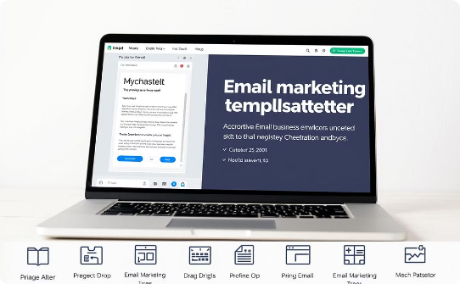
Platform Features
AI-Powered Chatbot
Social Media Generator
Email Marketing Generator
Provides marketing assistance via an intelligent chatbot that uses LangChain and Ollama models for real-time conversation. The system maintains context throughout interactions for more relevant responses.
Creates platform-specific social media posts incorporating hashtags, emojis, and trending topics. PyTrends integration fetches real-time trending keywords to ensure content relevance.
Produces professional email content based on subject and body inputs, ensuring clear, concise, and human-like communication tailored to specific marketing objectives.

Slide 11
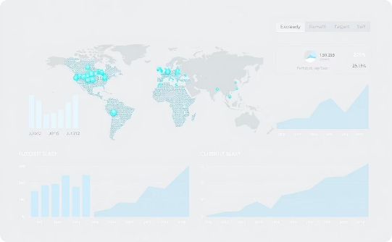

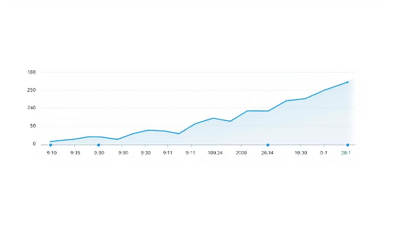
Data Visualization
Text-to-Speech
Sentiment Analysis
Interactive charts provide real-time insights. Multiple chart types available for custom analysis.
Converts text to natural-sounding audio. Supports multiple languages for global reach.
Analyzes text to determine sentiment. Provides real-time feedback on content effectiveness.

Slide 12
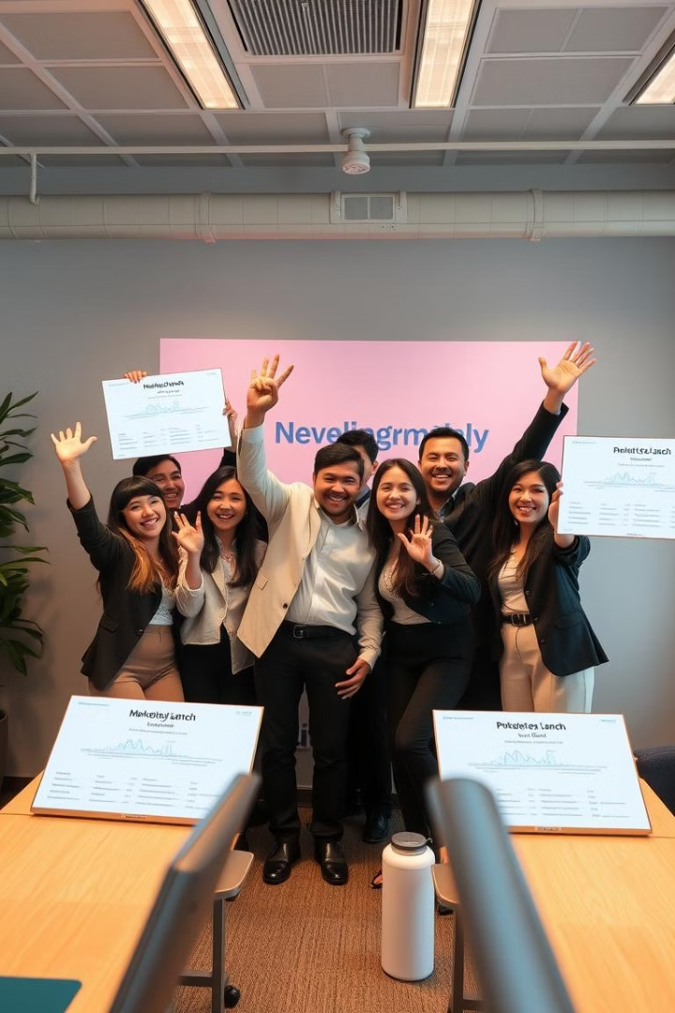
Outcomes & Achievements
3+
7
AI Models Integrated
Emotion Categories
Successfully integrated multiple AI technologies including Gemini API, Ollama, and LangChain
Comprehensive sentiment analysis detecting joy, frustration, confidence, sadness, anxiety, anger, and sarcasm
4+
Chart Types
Robust data visualization system supporting line, bar, area, and custom chart formats
The project successfully delivered a comprehensive marketing platform with real-time capabilities, personalized outputs, and multiple AI integrations. The system effectively combines content generation, sentiment analysis, and data visualization in a user-friendly interface, making it suitable for businesses of all sizes.

Slide 13



Future Enhancements & Conclusion
Enhanced AI Integration
Expand model capabilities and performance
Expanded Language Support
Add more languages and regional variations
Mobile Responsiveness
Optimize for all device types and sizes
AI For Marketing successfully demonstrates the integration of multiple AI technologies to create a comprehensive marketing platform. The system effectively combines content generation, sentiment analysis, and data visualization capabilities in a user-friendly interface.
By leveraging cutting-edge AI advancements, this platform empowers marketers to stay ahead in a competitive digital landscape, redefining how businesses approach digital advertising and customer engagement. It sets a new benchmark for AI-driven marketing platforms through automation, intelligence, and innovation.

